Slide 1
INFO 656-01 Fall 2020 What is Machine Learning?
Week 1
Amir Imani

Slide 2
Housekeeping
Email: aimani@pratt.edu
Office Hours: Mondays 7-9. Email me first!
Course website: https://github.com/Amirosimani/Machine_Learning_Pratt
Class discussion (30%)+ 4 Lab Assignments (20%)+ Final Project (10%+30%+10%)

Slide 3
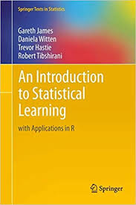
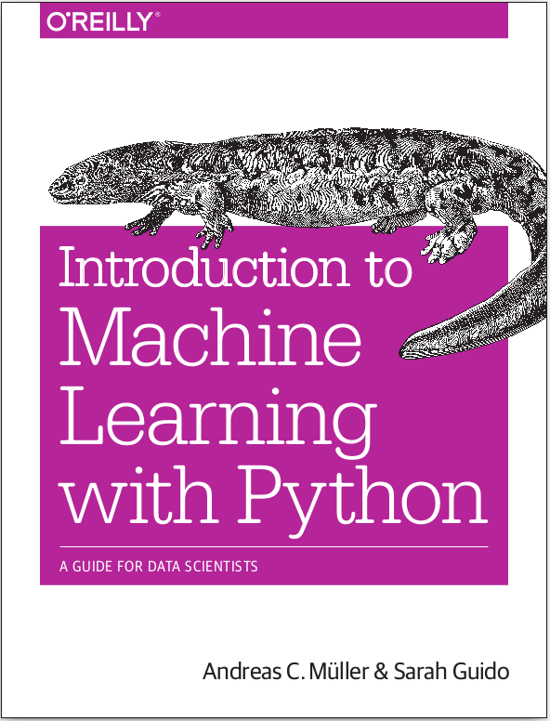


Books
http://ciml.info/

Slide 4
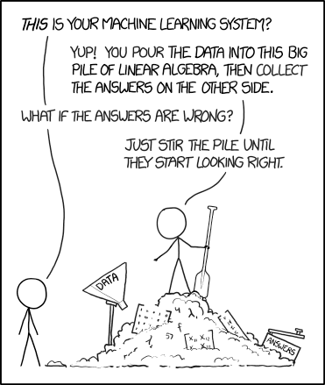
Machine Learning - What and Why

Slide 5
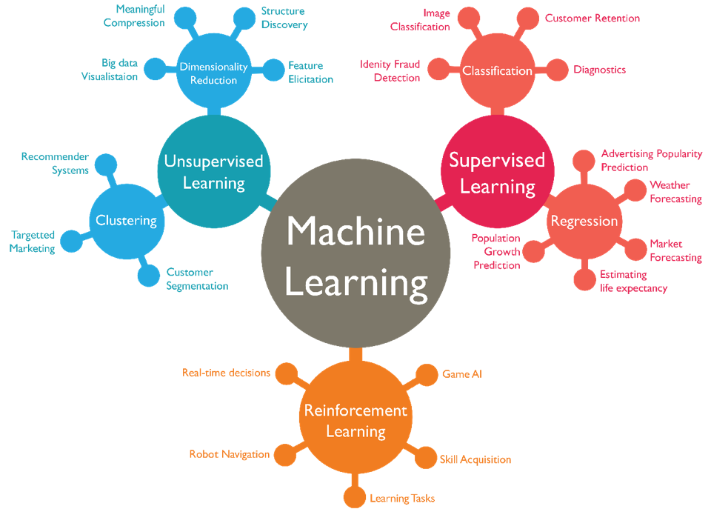
Types of Machine Learning

Slide 6
Other Machine Learning Considerations
Data and the collection process (week 2)
Machine Learning vs Statistics (multiple weeks)
Machine Learning workflow (week 8, 11)
FATML (Fair Accountable Transparent ML) (Week 2, 12, 13)

Slide 7
Coding
Coding is not fun, It’s technically and ethically complex! ¹

Slide 8
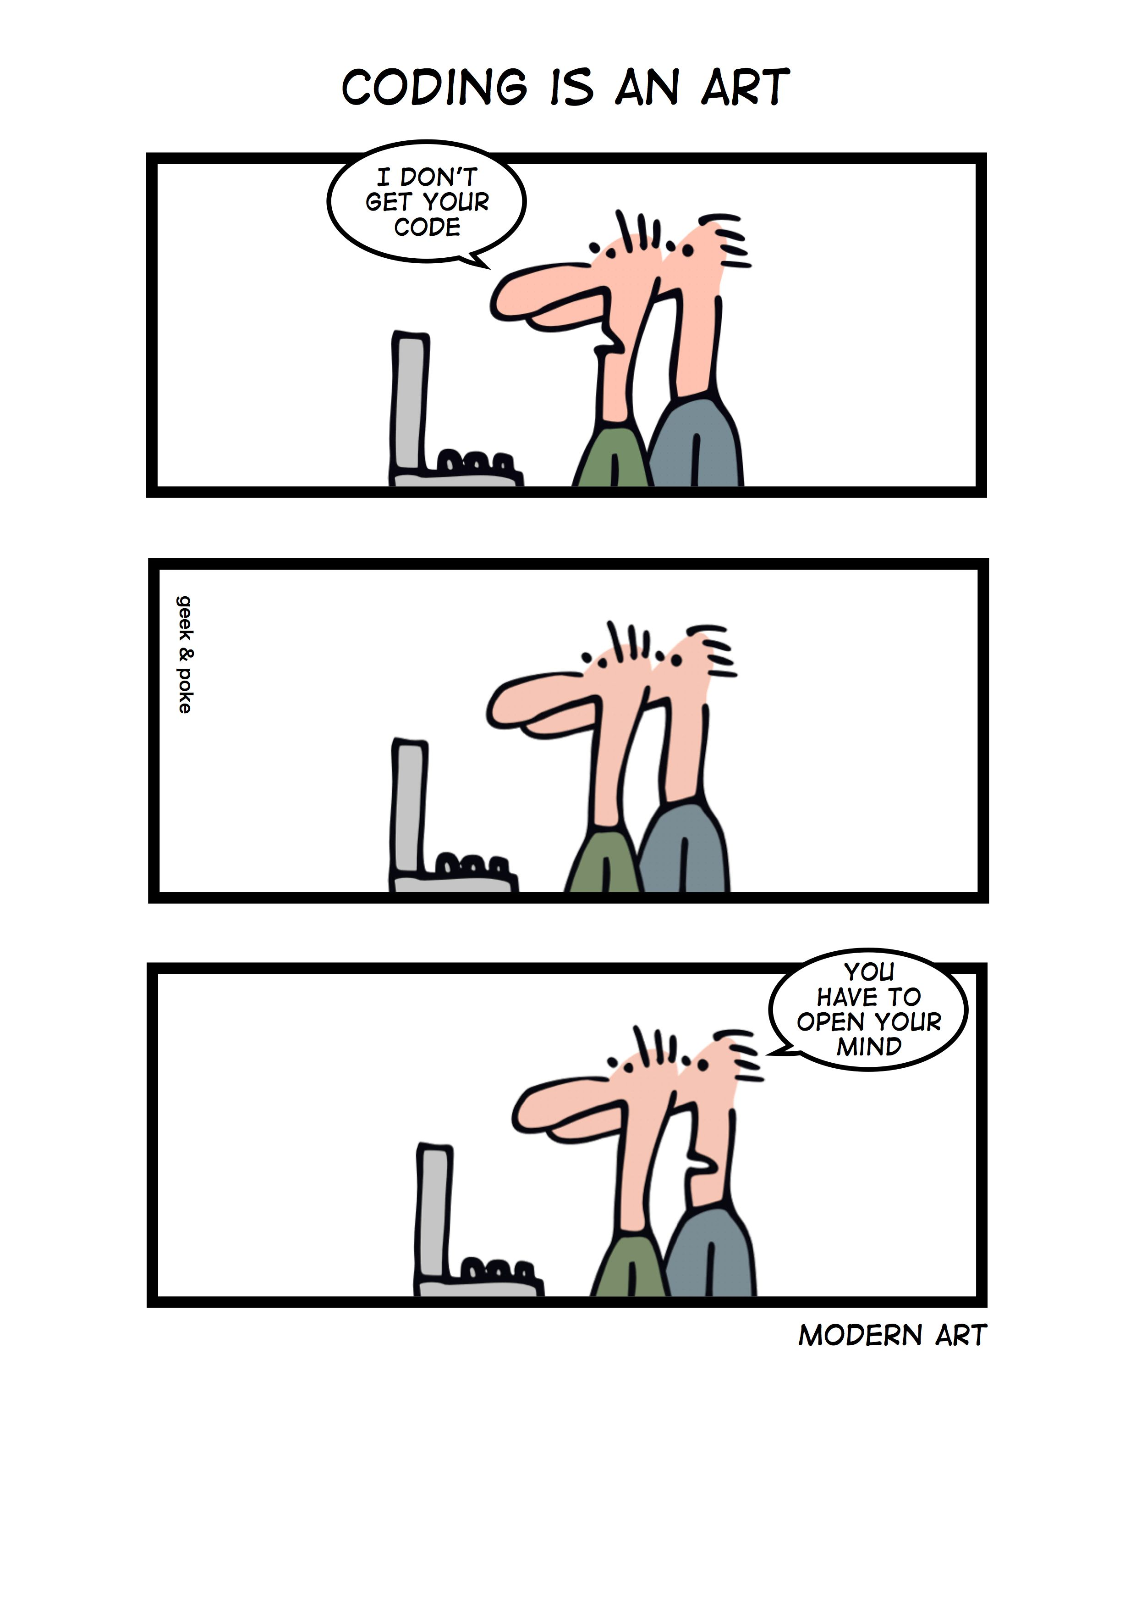
Coding
“Programs must be written for people to read, and only incidentally for machines to execute. ” — Harold Abelson
“Any fool can write code that a computer can understand. Good programmers write code that humans can understand.” — Martin Fowler

Slide 9
General Coding Guidelines
Don’t be clever!
Follow conventions.
Make it readable. Your feature self is the most likely the one who needs to understand it!

Slide 10
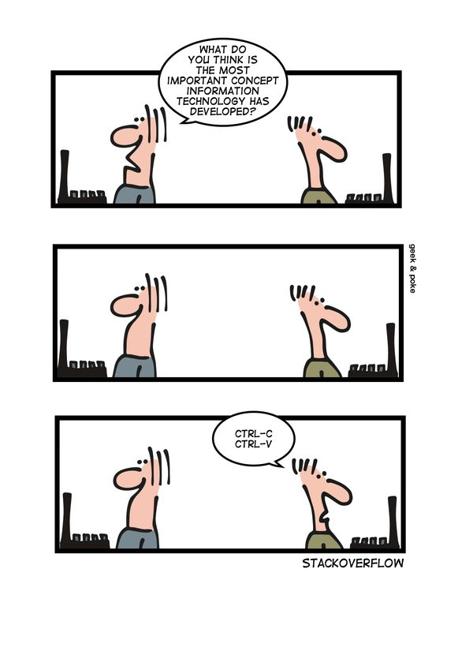
General Coding Guidelines
Don’t be clever!
Follow conventions.
Make it readable.
Avoid writing code.

Slide 11
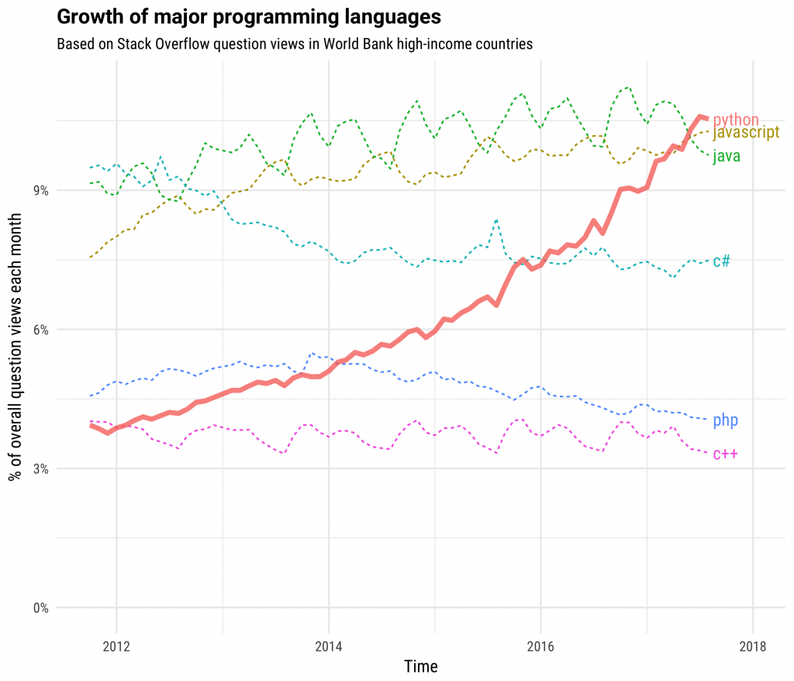
Why Python?
High-level and Interpreted
General-purpose
Multi-paradigm (OOP & Functional)
Modular
Interactive
Dynamic
Great Libraries
Easy to use

Slide 12
Code as an Artifact - Python Good Practices
Don’t use Python 2.x – unless you really have to!
Always create/use environments
Lint your code (PEP8)
Add comments
Modular coding

Slide 13
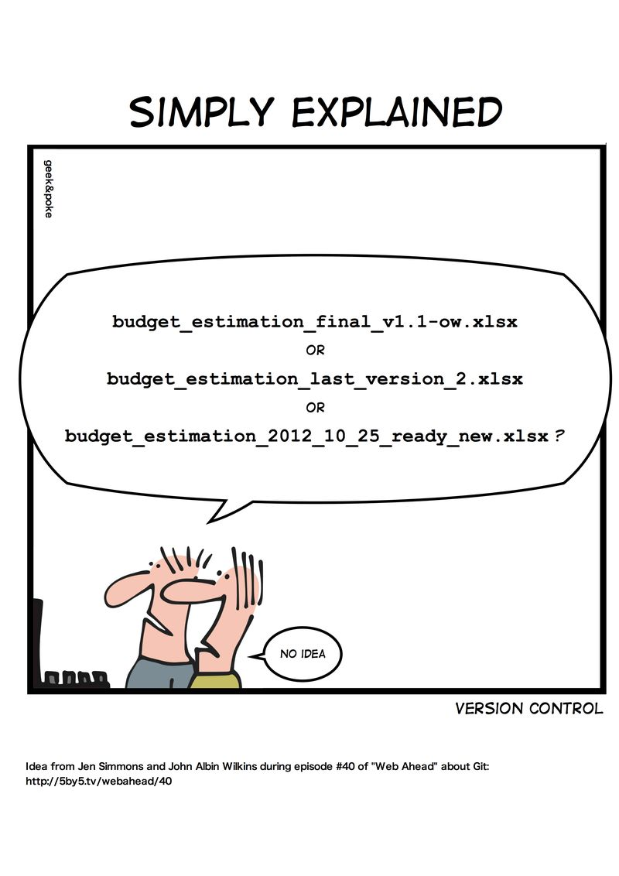
Version Control

Slide 14
Questions?

